Slide 1

Kevin Cookie Company Project
Rana Ahmad
15/11/2024

Slide 2

Company Brief
Kevin Cookie Company offers a variety of cookies globally. Founded in 2020 by Kevin Stratvert, a former software engineer, he pursued his passion for baking.

Slide 3

Overview of the project and Objectives
To create a dynamic and interactive sales dashboard using 5 different Pivot Tables, each providing a unique data summary.
The dashboard will include 5 different visuals based on these tables.
Use advanced Excel features like Pivot Tables, Slicers, Timelines, and Calculated Columns to present meaningful insights.

Slide 4
Data Structure
The dataset contains sales records for different products across various countries, including details on units sold, costs, profits, and dates.
Column: Country, Product, Units Sold, Total Cost, Total Profit, Date
Table Name | Records | Columns | Primary Key
Table 2 | 700 | 9

Slide 5

Clean Data
The data types for each column were not specified, such as whether they should be text, currency, or numbers. Additionally, the currency columns had dollar signs ('$') manually entered, which caused errors when using functions on those columns. To resolve this, a find-and-replace function was used to remove the dollar signs.

Slide 6
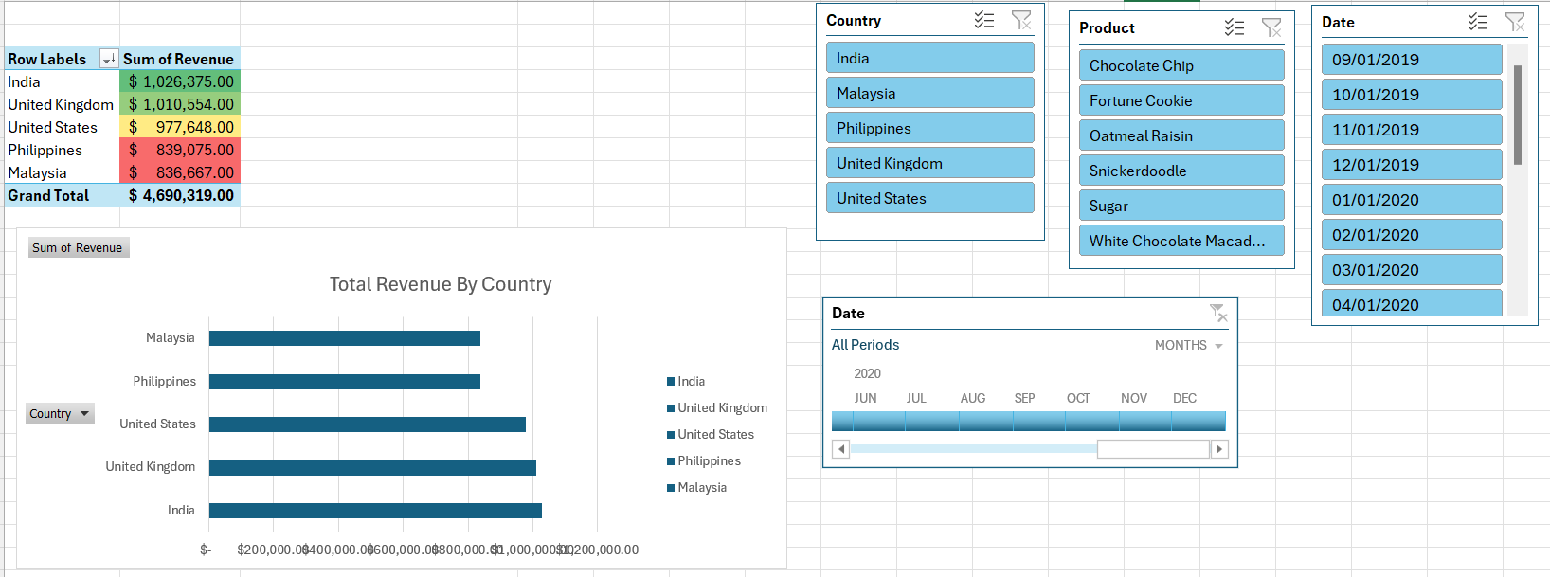
Total Revenue By Country
Kevin Cookie Company has identified India as its largest market, generating impressive revenue of $1,026,375. This significant sales figure underscores the strong demand for their products in the region. Additionally, the United Kingdom plays a crucial role as another key market for the company, contributing to its overall success and expanding its reach in the international cookie market. The company is focused on maintaining and growing its presence in both regions, leveraging their popularity to enhance brand recognition and drive future sales growth.

Slide 7
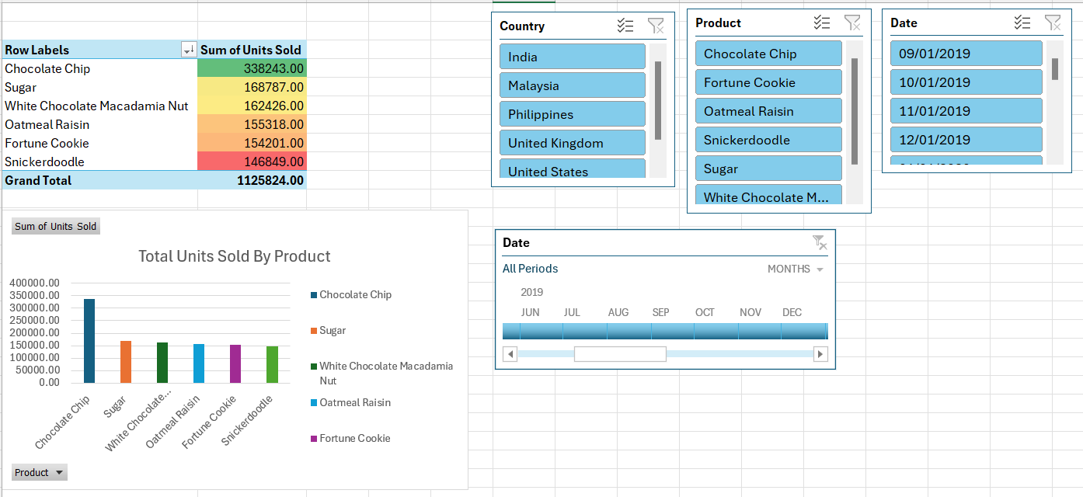
Total Units Sold By Product
The chocolate chip cookie stands out as the best-selling product, with a remarkable total of 338243 cookies sold in 2019. This classic treat has captured the hearts and taste buds of many, solidifying its popularity. Meanwhile, the other four products have shown consistent sales, each selling roughly the same number of units. This balance among the remaining offerings suggests a strong demand across the entire product range.

Slide 8
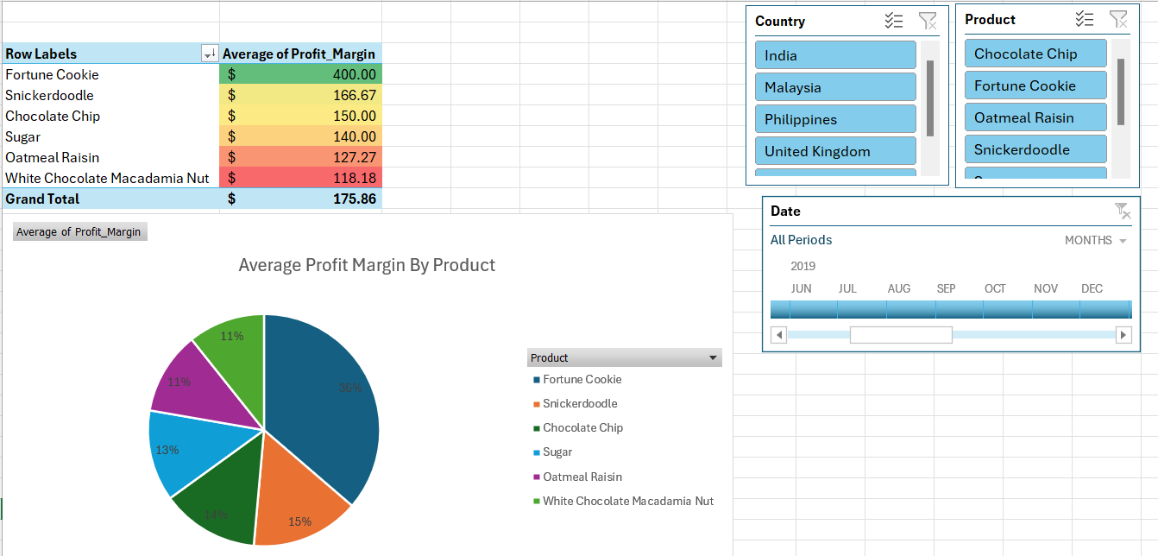
Average Profit Margin By Product
Fortune cookies have a high average profit margin of $400, making them very profitable in the cookie market. Their low production costs and unique appeal contribute to this margin. On the other hand, chocolate chip cookies have a lower average profit margin of $150. This shows that fortune cookies attract consumers with their special charm and provide more financial benefits for producers compared to chocolate chip cookies.

Slide 9
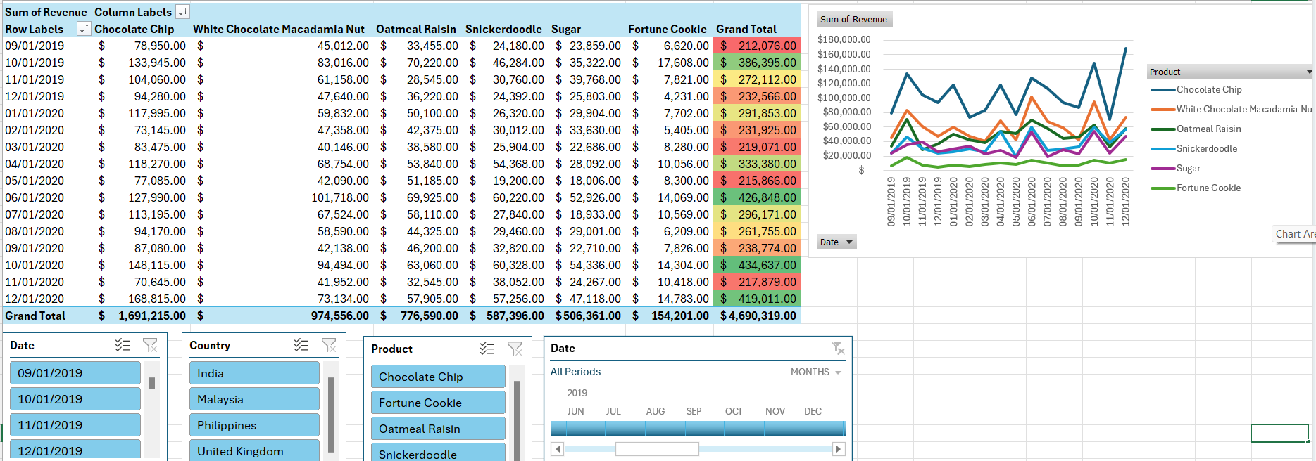
Total Revenue of Product over Time

Slide 10
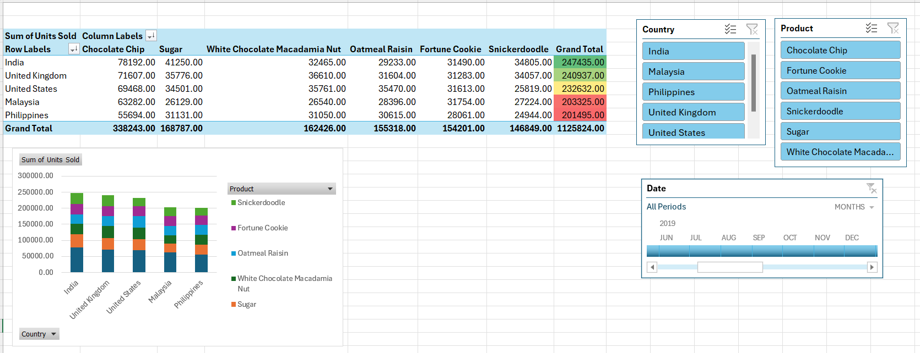
Units Sold By Country and Product

Slide 11
Insights and Recommendations
The chocolate chip cookie is the best-selling product, while the other cookie varieties show similar demand among one another. To encourage customers to try more products, the company could introduce a promotional offer where customers receive another cookie from the range at half price with the purchase of a chocolate chip cookie. This strategy would allow customers to sample other flavors, potentially enticing them to make future purchases.
Additionally, fortune cookies boast an impressive average profit margin of $400, making them one of the most profitable options in the cookie market. This high margin is due to their low production costs and the novelty factor associated with them. In contrast, the beloved chocolate chip cookies have a more modest average profit margin of $150. This difference emphasizes that while fortune cookies captivate customers with their unique appeal, they also provide greater financial benefits for producers compared to traditional chocolate chip cookies. Implementing promotional offers for fortune cookies could further boost sales and increase the company's overall revenue.

